Slide 1
Lending Club Case Study
Santosh Rameshkumar
Rahul Kumar Jain

Slide 2
Objective
The Objective of this case study is to implement EDA technique on a real world problem and understand the insights and present in a business first manner via presentation.
Benefits of the case study:
Gives a idea about how EDA is used in real life business problems.
It also develops a basic understanding of risk analytics in banking and financial services.
How the data is used to minimize loss of money while lending it to clients.
It improves our understating of visualization and what charts to use for real life data.

Slide 3
Business Understanding
The business objective is to take a decision whenever they receive a loan application whether to reject or approve based on certain variables.
Dataset Details:
The data given below contains information about past loan applicants and whether they ‘defaulted’ or not. Data has details regarding approved loan not the rejected ones. It has 3 status of loan which is Fully Paid, Current and Charged-Off.
Data Clean-up and preparation process:
Importing the Data
Removing large null value columns
Removing irrelevant columns
Removing/Fixing null values
Correcting data types and deriving new columns
Filter Data for requirement.
Removing Duplicate Data
Removing outliers

Slide 4
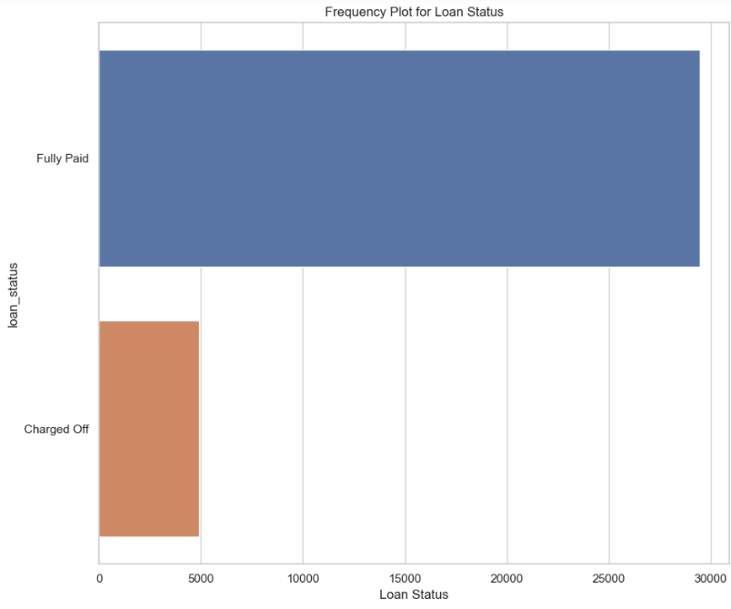
Loan Status and Count of Loans
Loan Status: The number of defaulted loan is 7 times less than the number of fully paid loan.

Slide 5
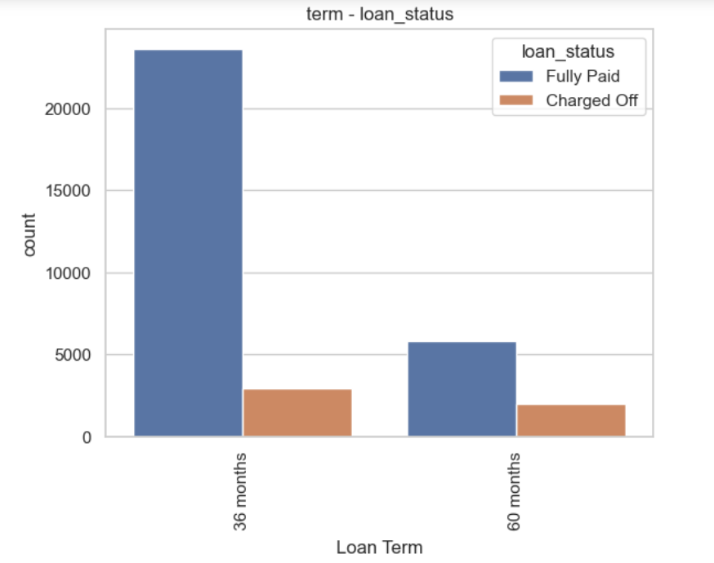
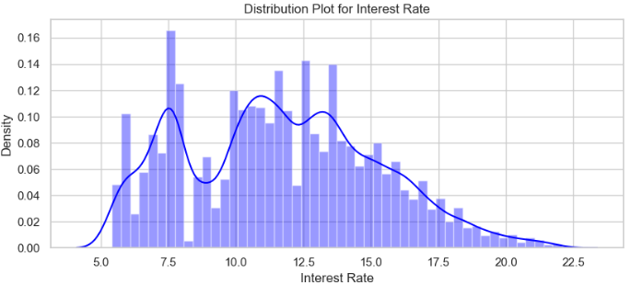
Term and Interest Rate
Loan Term: The Loans taken for 36 month term are much more than 60 months and have lower chance of defaulting.
Interest Rate: The count of loan taken varies with interest rate showing peak around in 5-15 bracket and decreasing slowly where as the chance of defaulting increases with interest rate.

Slide 6
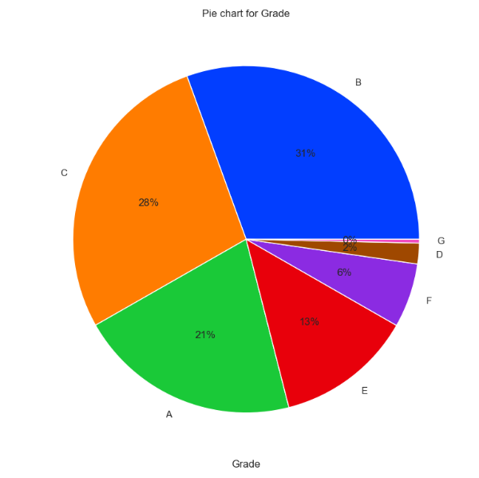
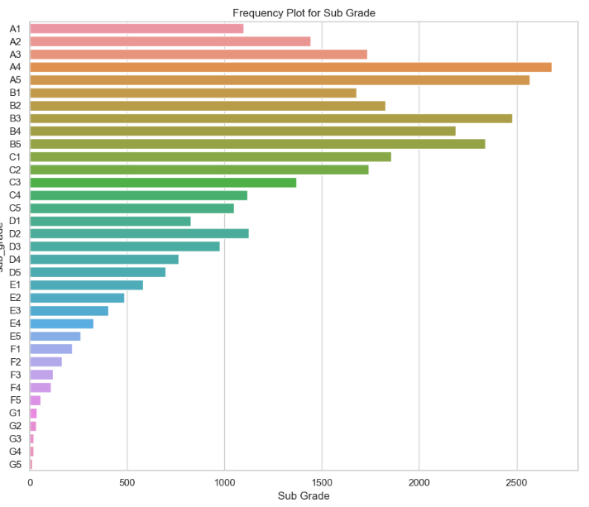
Grade and Sub-Grade
Grade: The loan approved are majorly of higher grade as they are of low risk thus low chance of defaulting.
Sub Grade: This provides more insight that the loans within grade are more skewed towards lowered sub grades.

Slide 7
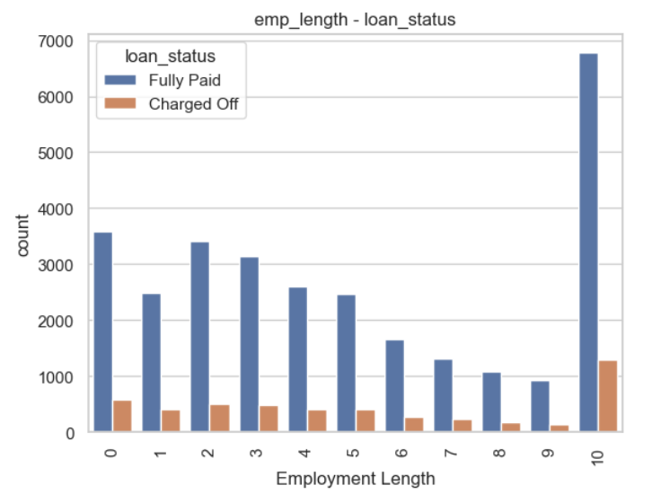
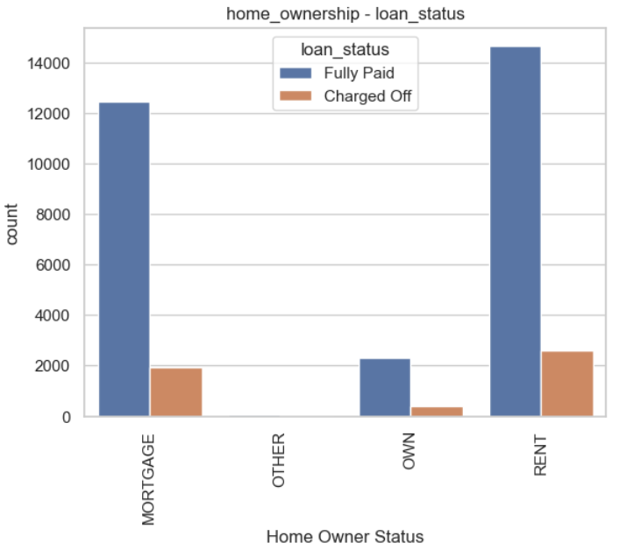
Employment Length & Homeownership
Employment Length: Majority of clients have 10+ years of experience and has highest number of defaulted loan.
Home Ownership: Majority of clients are lacking ownership of any property and are on rent or mortgage and have a higher chance of defaulting.

Slide 8
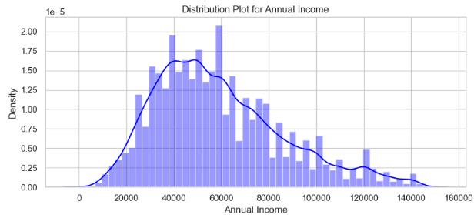
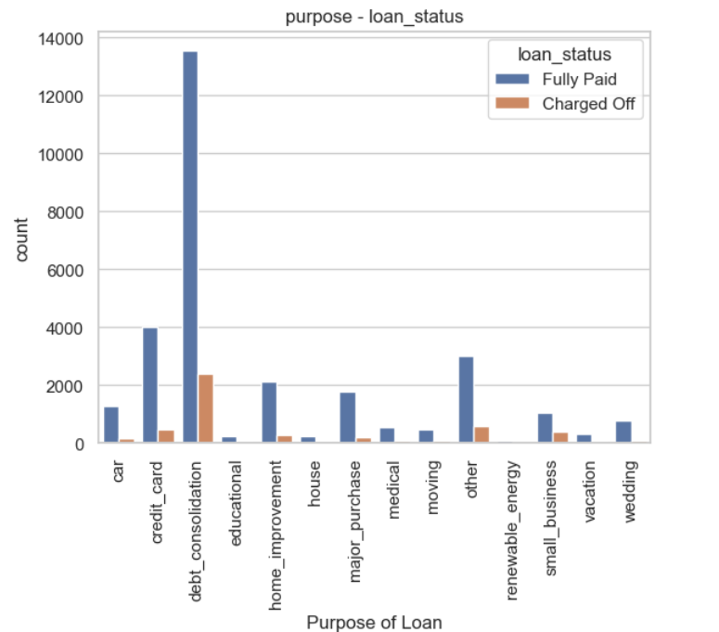
Annual Income & Purpose
Annual Income : The Majority of clients have low annual income compared to rest and income lower than 50k has higher chance of defaulting.
Purpose: Loans are taken mostly for debt consolidation followed by credit card payment. Whereas the debt consolidation has highest fully paid loan but also has highest defaulted loans as well.

Slide 9
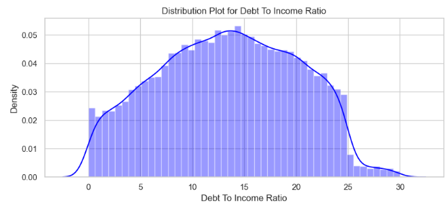
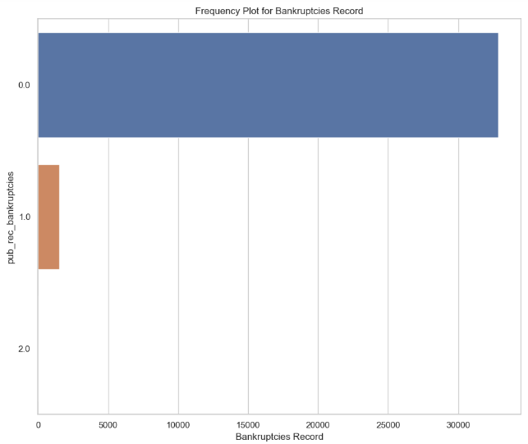
DTI ratio & Bankruptcy
DTI: The large percentage of Clients have a large Debt to Income ratio which shows that lending to such clients can be very risky.
Public Recorded Bankruptcy: Majority of clients have no record of declaring bankruptcy.

Slide 10
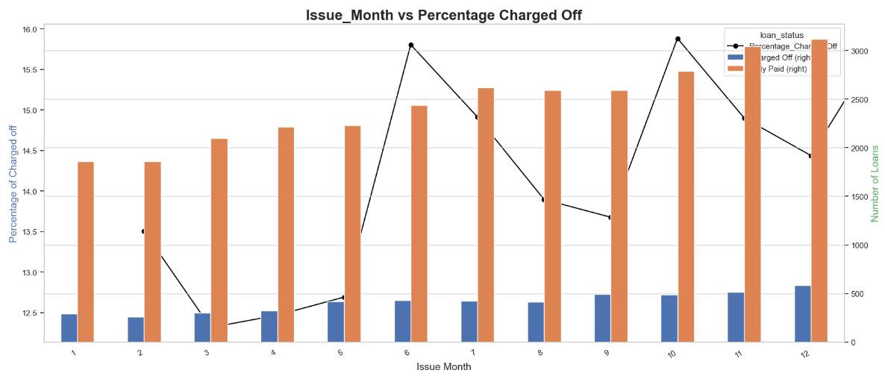
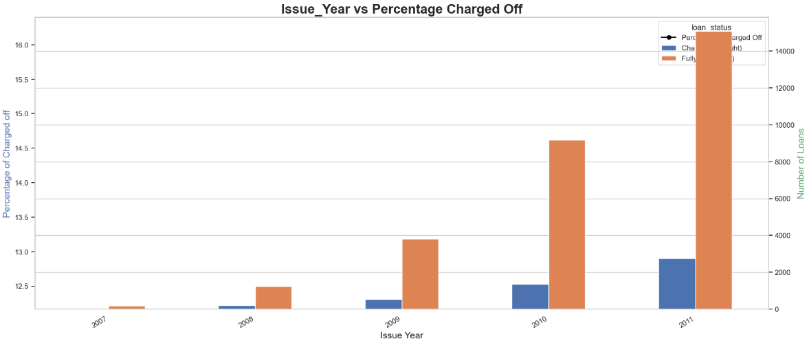
Loan Trend over years
We see a gradual increase in loan taken through the year, with lesser defaulting rate in April ,August, December quarter wise and better more late in year.
With each passing year loan taken are increasing exponentially which indicate we are seeing large increase in DTI ratio and decrease in defaulting rate.

Slide 11
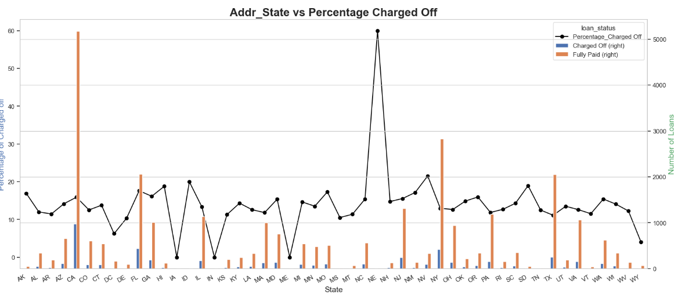
Location Based
For large metropolitan cities we see large number of loans, with higher number of defaulted loans like California, New York, Texas, Florida but have a lower chance of defaulting.

Slide 12
Univariate Analysis - Results
The number of defaulted loan is 7 times less than the number of fully paid loan.
Most of the loan has a term of 36 months compared to 60 months.
The interest rate is more crowded around 5-10 and 10-15 with a drop near 10.
A large amount of loans are with grade 'A' and 'B' compared to rest showing most loans are high grade loans.
Majority of borrowers have working experience greater than 10 years.
Majority of borrowers don't posses' property and are on mortgage or rent.
About 50% of the borrowers are verified by the company or have source verified.
Annual Income shows left skewed normal distribution thus we can say that the majority of borrowers have very low annual income compared to rest.
A large percentage of loans are taken for debt consolidation followed by credit card.
Majority of the borrowers are from the large urban cities like California, new york, texas, florida etc.
Majority of the borrowers have very large debt compared to the income registered, concentrated in the 10-15 DTI ratio.
Majority of the borrowers have no record of Public Recorded Bankruptcy.
Majority of the loans are given in last quarter of the year.
The number of loans approved increases with the time at exponential rate, thus we can say that the loan approval rate is increasing with the time.
No. of loans, fully paid and charged off are increasing every year. They are at maximum in the year 2011. This is a very positive trend for Lending Club as the requirement of loans are increasing by each year.
The month-wise trend shows that most loans are fully paid as well as charged off as the year comes to an end, maximum in the month of December clearly stating the importance of year-end.
Around 90% borrowers are having no public derogatory records.
99% people have not gone bankrupt.
The lending club(LC) has doubling loan issues every year.
There are more issues of loan in last 3 months every end of the ear i.e., Oct, Nov and Dec.
Most of the borrowers are from CA, FL and NY

Slide 13
Segmented Univariate Analysis - Results
Debt Consolidation is the most popular loan purpose and has highest number of fully paid loan and defaulted loan.
The mean and 25% are same for both but we see larger 75% in the defaulted loan which indicate large amount of loan has higher chance of defaulting.
The 60 month term has higher chance of defaulting than 36 month term whereas the 36 month term has higher chance of fully paid loan.
The loans in 36 month term majorly consist of grade A and B loans whereas the loans in 60 month term mostly consist of grade B, C and D loans.
The Loan Status varies with DTI ratio, we can see that the loans in DTI ratio 10-15 have higher number of defaulted loan but higher dti has higher chance of defaulting.
The Defaulted loan are lower for the borrowers which own their property compared to on mortgage or rent.
Borrowers with less 50000 annual income are more likely to default and higher annual income are less likely to default.
The Fully paid loan are increasing exponentially with the time compared to defaulted loan.
The default loan amount increases with interest rate and shows are decline after 17.5 % interest rate.
The Employees with 10+ years of experience are likely to default and have higher chance of fully paying the loan.
Looks like there are more proportion of borrowers defaulted loan in 60 months term then 36 months. Also the Fully Paid rate is higher in 36 months tenure.

Slide 14
Bivariate Analysis - Results
The Grade represent risk factor thus we can say interest rate increases with the risk.
The Grade A which is lowest risk also has lowest DTI ratio which we can say that higher grade has lower rate of default.
The borrowers are mostly having no record of Public Recorded Bankruptcy and are safe choice for loan issue.
Maximum no. of loans are applied by people from CA.
Maximum no. of loans are charged off for people of NV.
% of loans getting charged-off for 60 month term i.e.. 25.2% is higher as compared to 36 month term i.e. 10.9%
Total no. of loan applications are very high for 36 month term as compared to 60 month term.
Grade A and B loans are safe. Within these the sub-grades A4 and B3 have the highest number of loan applicants.
Grade E, F, G loans are less safe as compared to others.
As the Interest Rate is increasing, The % of loan getting charged off is also increasing. It is minimum for interest rate below 7.5.
Maximum loans are applied by applicants where the interest rate is between 10 and 15%.
As the Annual Income is increasing, The % of loan getting charged off is decreasing. It is minimum for income more than 100000 and maximum where annual income less than 25000.
Maximum loans are applied by applicants whose annual income is between 25000 and 75000.
As the loan amount increases, The probability of loan being charged off increases. It is maximum, 29.47% for the amount of 30,000+
The maximum no. of loans, 12410 are applied where the loan amount ranges between 5000 and 10000.
Maximum no. of loans i.e. 17487 are accepted for the purpose of Debt Consolidation out of which 14827 are fully paid and 2660 are charged off i.e. 15.2%
Maximum % of a loan being charged off is for the purpose of small business and the % is 27.1.
Loan amount is not a decider for defaults in both 36 and 60 months.
Borrowers have equal distribution is both default and non default for 36 and 60 months tenures.
For higher interest rates the default rate is higher in both 36 and 60 months tenure.
Comparatively charge-off are higher when compared with fully-paid for the Debit to income ratio.
Home loans with high interest rates are mostly defaulted. Even small business and debt consolidation has similar observation.
Small Business has more defaults when the loan amount is also high.
Charged-off are higher for small business comparatively.
There is bit high percentage of defaults are recorded in other home ownership category.
The Charged off % increases as grades decreases.

Slide 15
Recommendations
Lending Club should be wary of the loans where the purpose is Small Business as the percentage of a loan being charged off is maximum 27.1%. Accepting loans for the purpose of Weddings, major purchase, car and credit card is highly recommended.
Higher the loan amount, the higher the chances of loan being charged off. Therefore, Lending Company should consider accepting loans of lower amount. The maximum no. of loans, 12410 are applied where the loan amount ranges between 5000 and 10000. For this range the probability of the loan getting charged off is very less. Hence the risk factor is low for lending club.
Lending Club should consider accepting more loans from applicants whose annual income is greater than 100000 as their probability of charge off is minimum.
Lending Club should consider accepting more loans where interest rate is less than 7.5% as their probability of charge off is minimum.
Lending Club should consider accepting more loans of grade A and B. It should be cautious of loans falling in grades E,F and G
Lending Club should consider accepting more loans from people who owns a house.
The number of loan applicants are increasing with each passing year bringing more business to Lending Club which is leading to more loans getting accepted as well as more loans getting charged off. Moreover, the last few months of the year are quite critical as most of the loans are either fully paid or charged off at that time.
Lending Club should accept more loans for the term of 36 months as the % of charged off loans is less, and the no. of loan applicants are more. Also, the avg fully paid loan amount is increasing over the years and avg charged off loan amount is decreasing over the years.

